Slide 1

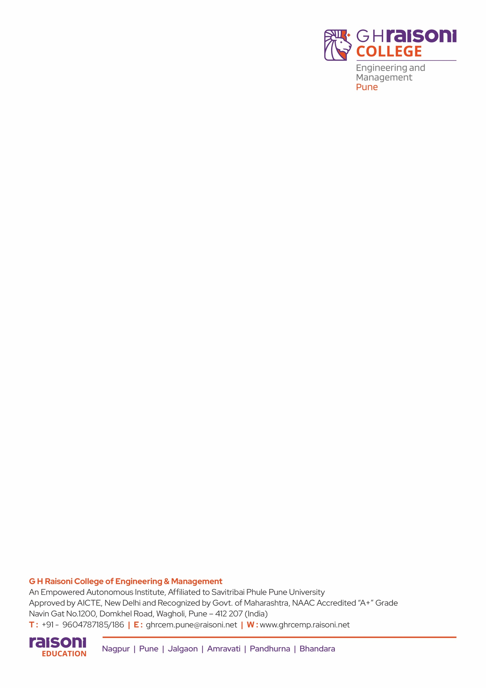
Department of MCA
SYMCA ‘B’
Academic Year- 2025-26
Subject: Minor project
Topic: VisionAI Object Detector
Name of Student:
Rohit Kadam: SYMCA-(A)45
Animesh Jain : SYMCA-(A)46
Internal Guide: Asst. Prof. Rasika Salunkhe

Slide 2
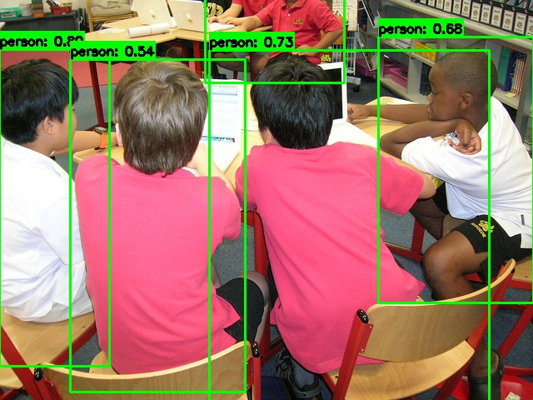
Introduction
Manually monitoring surveillance feeds or analyzing visual data is a slow, inefficient, and error-prone task. The VisionAI Object Detector is an intelligent computer vision platform designed to automate this process by detecting, tracking, and analyzing objects in real-time. Using a webcam or video file, the system leverages a YOLO (You Only Look Once) model ensemble to identify objects like vehicles, people, and other items. It features an interactive Streamlit dashboard for data analysis and a standalone monitor that sends Telegram alerts when an object enters a user-defined restricted zone.

Slide 3
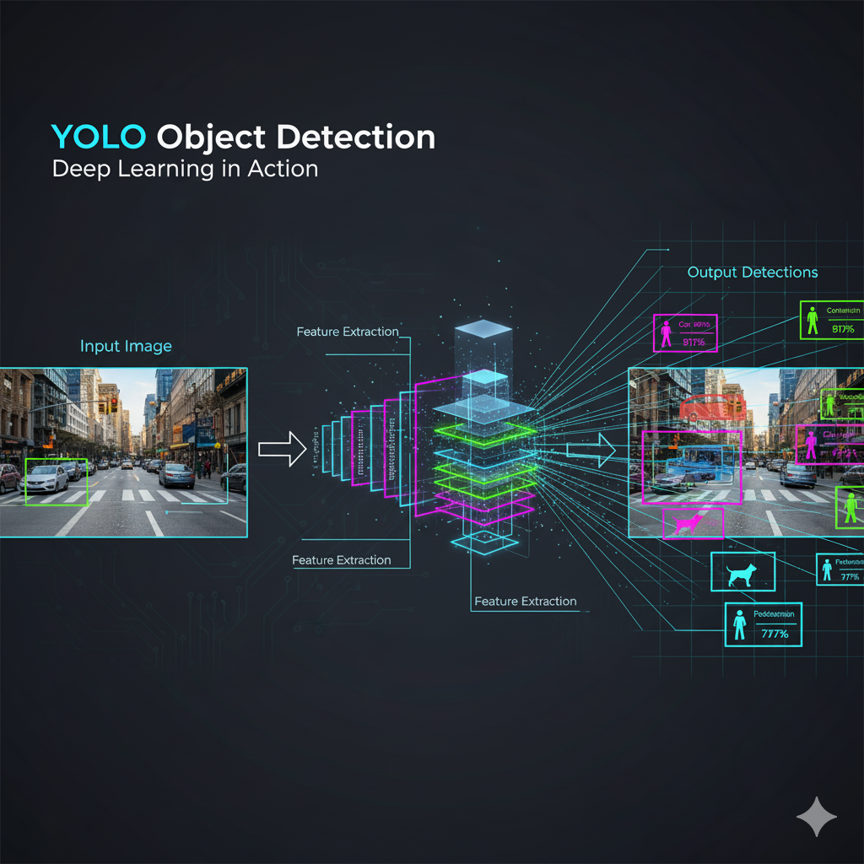
Importance
The VisionAI Object Detector is a comprehensive, Python-based computer vision platform. Its primary function is to automate the detection, classification, and tracking of objects from visual inputs (images or video). It leverages deep learning (YOLO) model ensembles to process data and provides multiple interfaces—including a command-line launcher and an interactive web dashboard—for user interaction, data analysis, and real-time alerting.

Slide 4
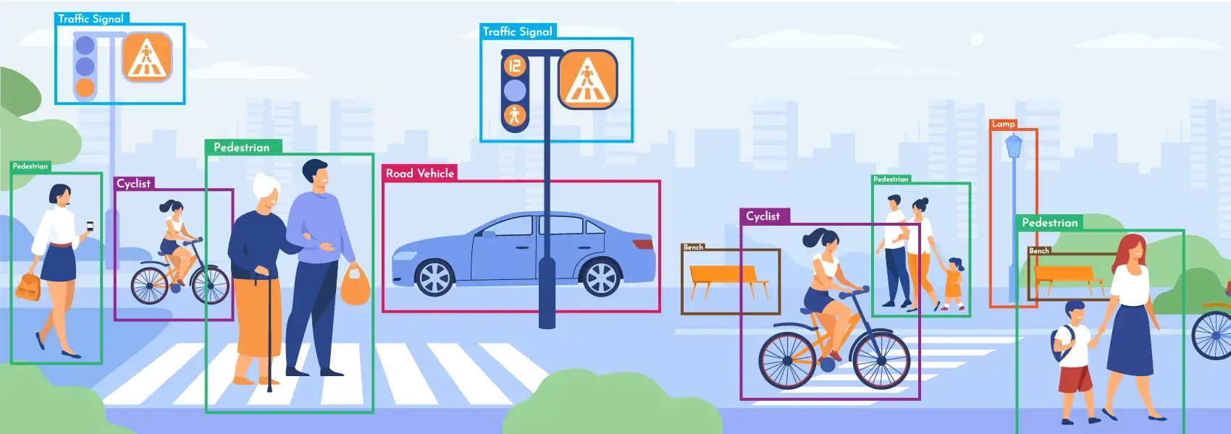
Abstract
This project is an advanced VisionAI Object Detector built with Python, OpenCV, and Streamlit. It uses a YOLO model ensemble to detect, classify, and track objects in real time. The system features a comprehensive web dashboard with interactive controls, live analytics, and confidence filtering. It also includes a standalone security monitor that automatically sends Telegram alerts when objects enter a pre-defined restricted zone, providing a complete solution for visual analysis.

Slide 5
Overview
VisionAI Object Detector is a complete platform that goes beyond simple detection to include analysis and user interaction.
Core Function: It uses YOLO ensemble models to detect, classify, and track objects in real-time from images or webcam feeds.
Three Main Features: The project is unified by a main interactive menu (main.py) that lets you launch three distinct applications:
A Web Dashboard (dashboard.py): This is your main user interface. It's an interactive Streamlit website that allows users to upload, select, or capture images, and then analyze the results.
A Standalone Security Monitor (detector.py): This script runs on its own, watches a live webcam for objects in a "Restricted Zone," and automatically sends Telegram alerts with a snapshot.
Demos & Tests: Various scripts to test the detection (ensemble_demo.py) and analytics (test_analytics.py) logic from the command line.

Slide 6
Hardware and Software
Advanced Interactive UI: The web dashboard is the project's highlight. Its key features are:
Interactive Filtering: A live slider that lets you filter all detections by confidence after the analysis is done.
Tabbed Results: A clean layout that separates the visual image, a data table of results, and the live analytics.
Live Analytics: An "Analytics" tab that instantly shows you key metrics for that specific image (total objects, average confidence, etc.).
Powerful Backend: The system is powered by modular backend classes:
AdvancedEnsemble: The "brain" that connects the model, tracker, and analytics.
DetectionAnalytics: A powerful engine that logs all session data and can generate summary reports as JSON files or charts.

Slide 7
Hardware and Software
Hardware Requirements
CPU: Intel Core i5 / AMD Ryzen 5 or better
RAM: 8 GB (16 GB Recommended for better performance)
GPU: NVIDIA GPU with CUDA support (Highly Recommended for real-time detection)
Input: Built-in or USB Webcam
Storage: 5 GB free space
💻 Software Requirements
Operating System: Windows 10/11
Core Language: Python 3.9+ (Managed with a venv)
Key Python Libraries:
streamlit (For the web dashboard)
opencv-python (For all vision tasks)
numpy (For data calculation)
pandas (For data tables)
requests (For Telegram alerts)

Slide 8
Advantages and Disadvantages
Advantages (Strengths)
Easy-to-Use UI: The Streamlit web dashboard is graphical and accessible to anyone.
Real-Time Alerts: The detector.py security monitor is a complete, practical feature that sends live Telegram alerts.
Interactive Analytics: The dashboard provides a "Live Analytics" tab and a confidence slider that lets users filter results in real-time.
Zero Cost: The entire system is built using 100% free and open-source software (Python, OpenCV, Streamlit).
Disadvantages (Limitations)
Limited Detections: The system can only detect the 80 object classes from the pre-trained COCO dataset.
Hardware Dependent: Real-time performance requires a powerful NVIDIA GPU; it will be slow on standard CPU-only laptops.
Basic Tracking: The tracker can fail when objects cross paths (occlusion) or move too quickly.
Snapshot-Only Dashboard: The dashboard's webcam feature takes a single picture; it does not process a continuous live video feed.
Hardcoded Settings: The "Restricted Zone" in the security monitor is set in the code and cannot be drawn or changed in the UI.

Slide 9
ER-Diagram

Slide 10
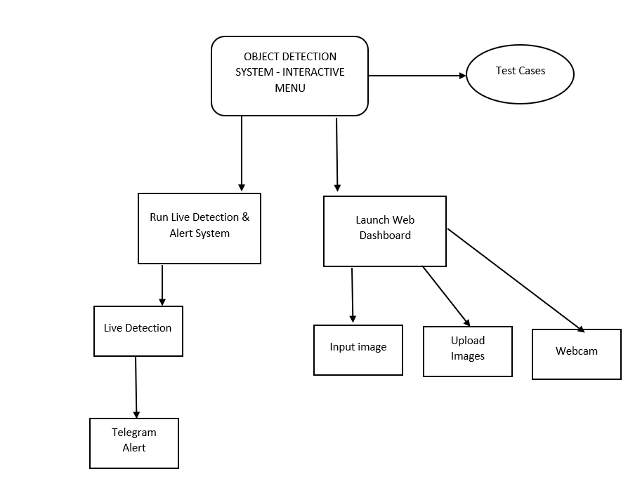
Module Hierarchy Diagram

Slide 11
Use Case
1. Interactive Data Analysis (via Web Dashboard)
Upload, select, or capture an image for immediate processing and analysis.
Instantly filter all detected objects (on the image, in tables) using the interactive confidence slider.
View live, per-image analytics (total objects, average confidence) in a clean, tabbed layout.
Generate historical reports for an entire session to track performance over time.
2. Automated Security & Alerting (via Standalone Monitor)
Run a 24/7 monitor on a live webcam feed to watch a specific area.
Detects any object (like a person or vehicle) that enters a pre-defined "Restricted Zone."
Automatically sends an instant Telegram alert with a snapshot image to a security official or owner.
3.Unified Project Launcher (via main.py)
Provides a simple, user-friendly interactive menu in the terminal.
Acts as a central "command center" to easily launch all other features (the Dashboard, the Security Monitor, or Demos) without needing to remember complex commands.

Slide 12
Existing And Proposed System
Existing System
A multi-interface object detection platform built with Python, OpenCV, and Streamlit. The system is fully functional and unified by a central launcher.
Interactive Menu (main.py): A command-line menu that acts as a single, user-friendly launcher for all project features.
Web Dashboard (dashboard.py): An interactive Streamlit web app for analysis. Key features include:
Multiple Inputs: Upload, select from a folder, or webcam snapshot.
Interactive Filtering: A real-time confidence slider to filter all results.
Tabbed Analytics: A clean UI that separates the visual result, a data table, and live, per-image analytics.
Security Monitor (detector.py): A standalone script that monitors a live webcam, detects objects in a hardcoded "Restricted Zone," and sends live Telegram alerts with snapshots.
Backend Logic: Includes an analytics engine (performance_analytics.py) that saves reports as JSON/PNG files and a basic IoU-based object tracker (object_tracker.py).

Slide 13
Existing And Proposed System
Proposed System (Enhancements)
Custom Model Training: Add a UI for users to upload their own datasets and train models to detect custom objects (beyond the 80 COCO classes).
Advanced Tracking: Upgrade the basic tracker to a more robust algorithm (like DeepSORT or ByteTrack) to better handle complex scenarios where objects cross paths (occlusion).
Dynamic Restricted Zone: Allow users to draw a custom polygon on the dashboard's video feed to define the security alert zone, rather than using hardcoded coordinates.
Database Integration: Replace the flat-file (JSON) analytics logging with a proper SQL database (e.g., PostgreSQL) to allow for scalable, long-term, and queryable data storage.
Multi-Channel Alerts: Expand the notification system beyond Telegram to include other channels like Email and SMS.

Slide 14
Future Scope
Custom Model Training: Add a UI for users to upload datasets and train models to detect custom objects (beyond the 80 COCO classes).
Advanced Object Tracking: Upgrade the basic tracker to a more robust algorithm (like DeepSORT or ByteTrack) to better handle complex, crowded scenes and occlusions.
Dynamic Alert Zones: Allow users to draw a custom polygon on the dashboard's live feed to set the "Restricted Zone," instead of using hardcoded coordinates.
Live Video in Dashboard: Re-architect the web dashboard to process a continuous, real-time video stream from the webcam, not just static snapshots.
Database Integration: Replace the current JSON file logging with a proper SQL database to enable scalable, long-term storage and complex data queries.

Slide 15
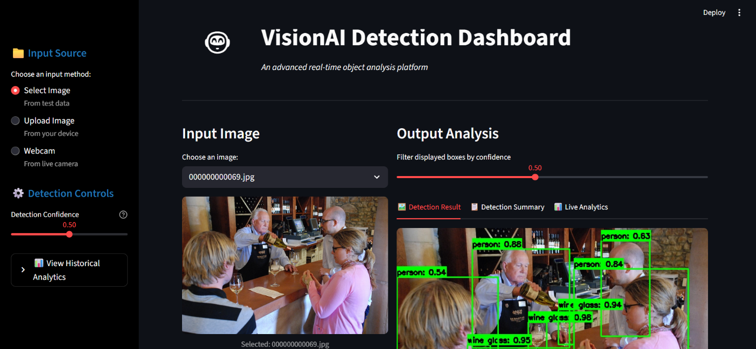
Snapshot
VisionAI Detection Dashboard

Slide 16
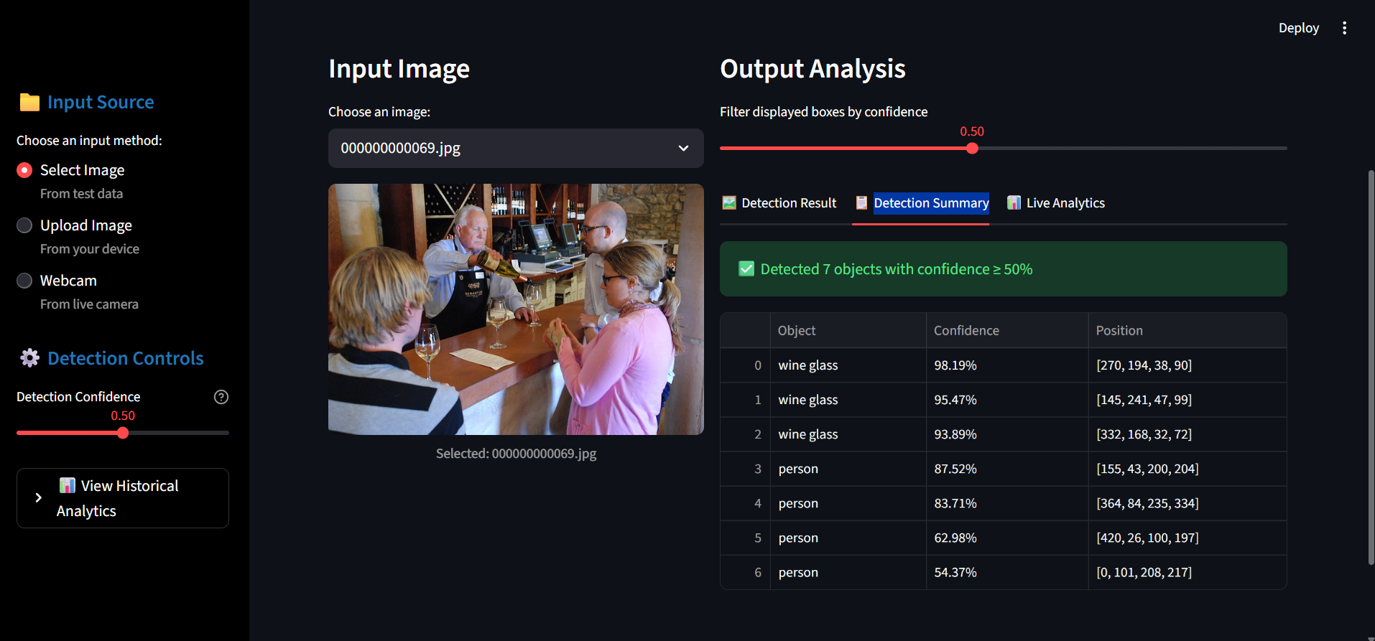
Snapshot
Dashboard Summary

Slide 17
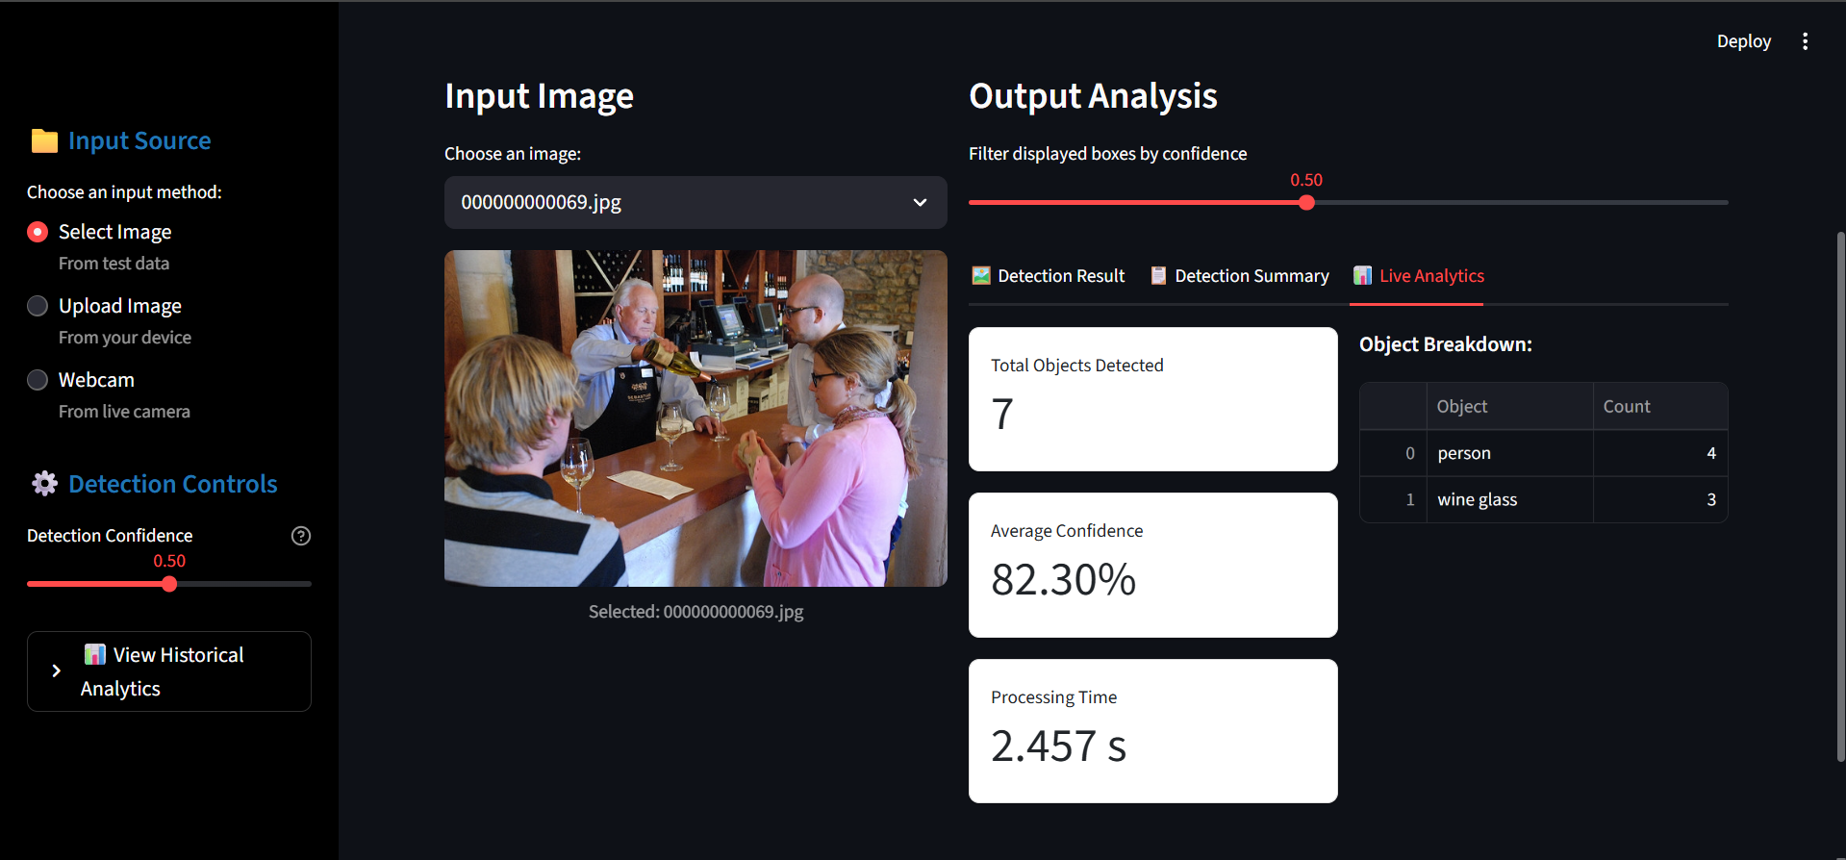
Snapshot
Live Analytics

Slide 18
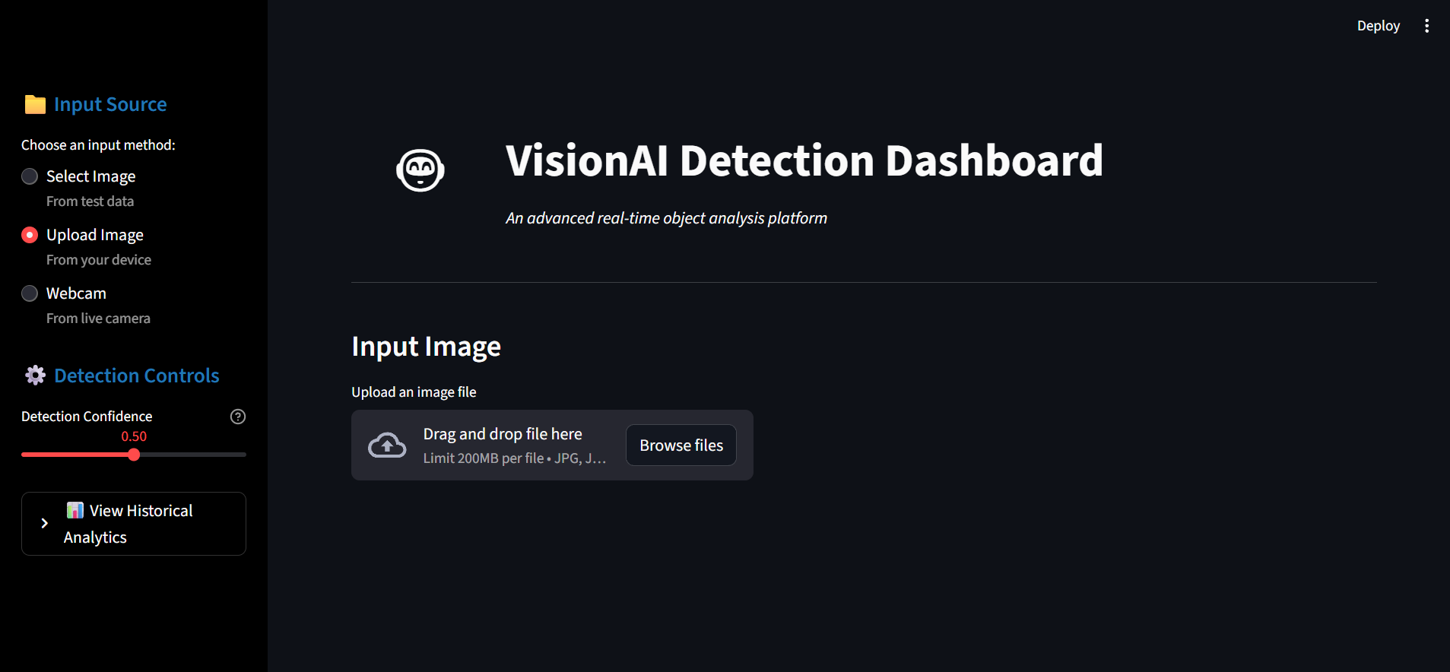
Snapshot
Manual Image input

Slide 19
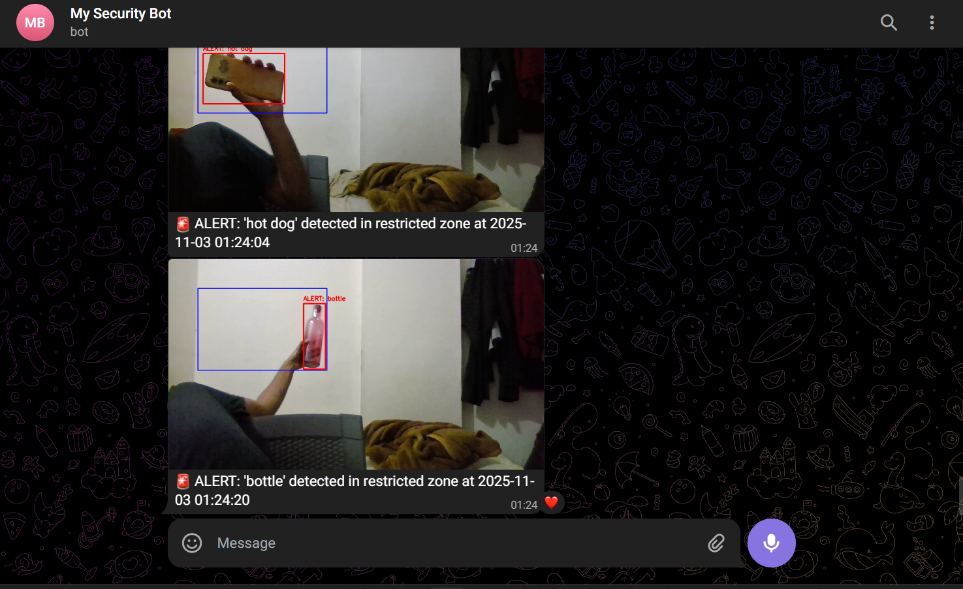
Snapshot
Telegram Alert

Slide 20
Conclusion
This project successfully evolved from a basic script into a comprehensive object detection platform. The initial technical challenges of a broken codebase were overcome, resulting in a robust and modular application.
The final system features three main components: a unified interactive menu (main.py), a standalone security monitor (detector.py) with live Telegram alerts, and a sophisticated Streamlit web dashboard (dashboard.py). By integrating an analytics engine and interactive filtering, the project moves beyond a simple demo to become a powerful, user-friendly tool for real-world analysis, validated by testing and ready for future expansion.

Slide 21
THANK YOU

